Slide 1
DPP FOR FFT
Environment：
Vega20 60 cu
Data type = float2
FFT length = 2048
Group size = 1024
4 wave per SIMD; 16 wave per CU
Method:
1 origin
2 dpp
3 dpp with twiddle in lds
4 dpp with twiddle in flight

Slide 2
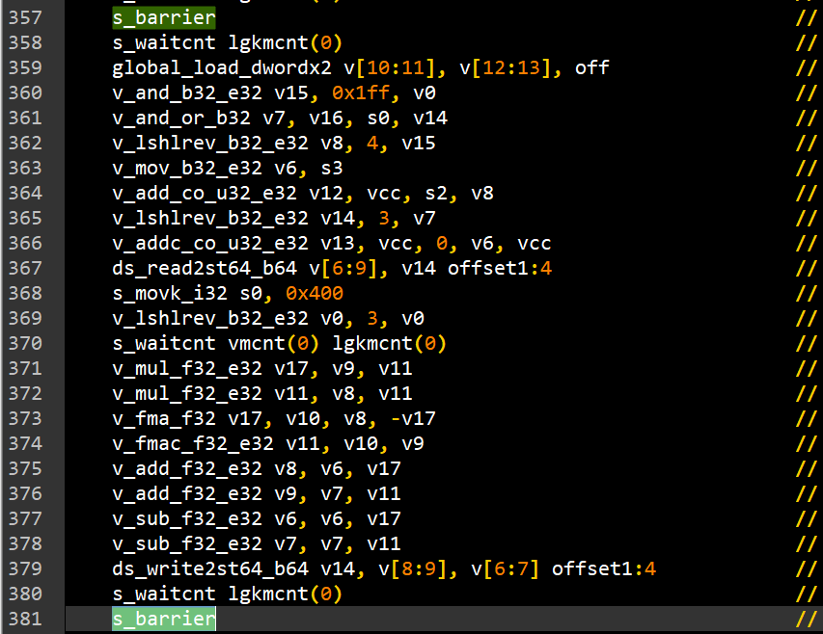
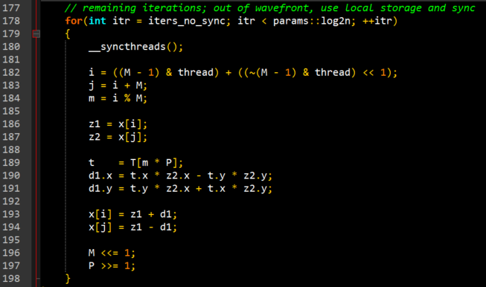
DPP FOR FFT
Method 1
Method 1: origin
Use lds-sync to do data exchange

Slide 3
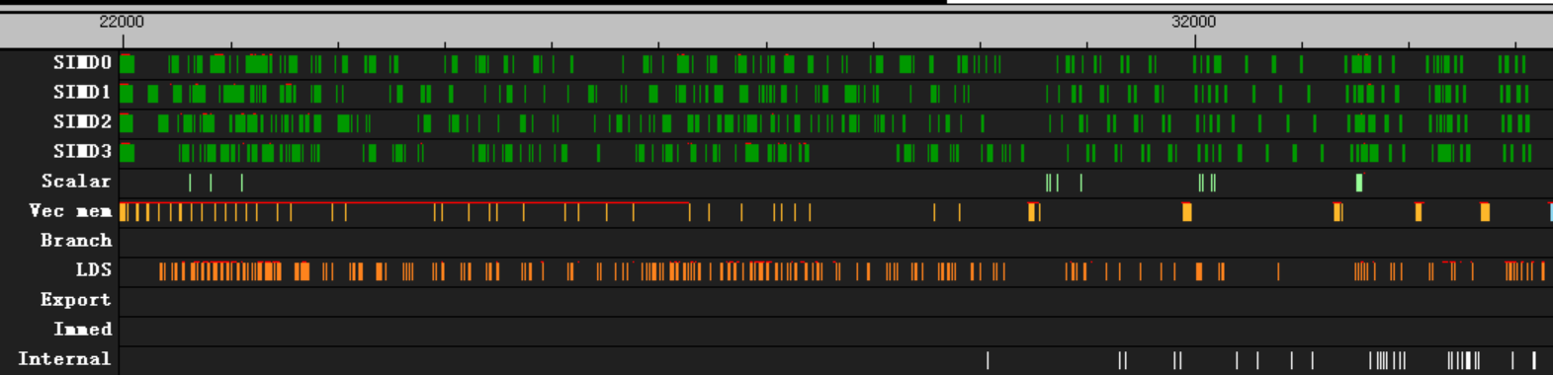
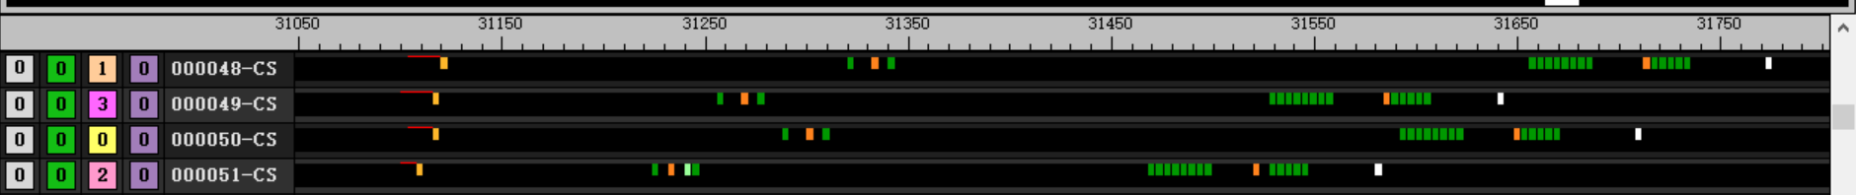
DPP FOR FFT
Method 1
Method 1: origin
need to wait global read and lds read/write opt are finished (not good)
Another wave could use VALU while one wave is waiting (good)
656 clk
load twiddle
wait read complete
wait write complete
read x from lds
write result to lds

Slide 4
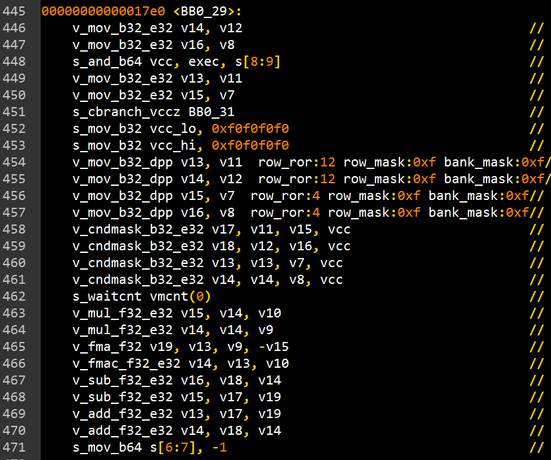
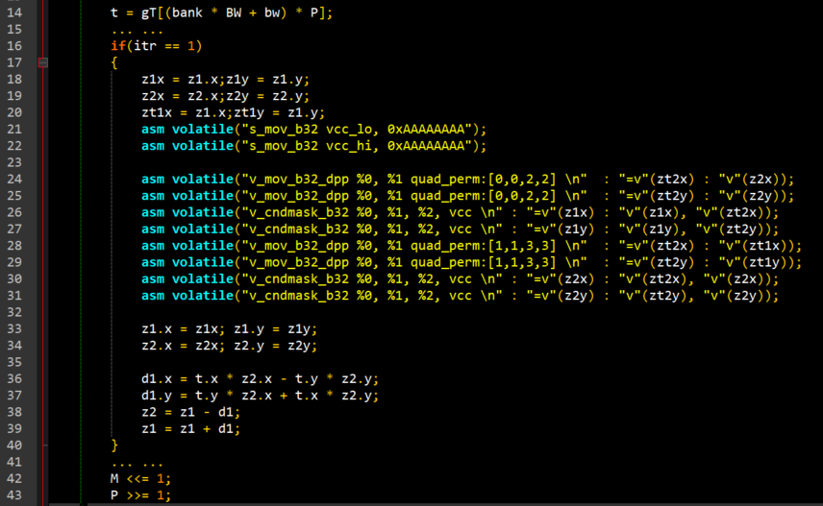
DPP FOR FFT
Method 2
Method 2: dpp
Increase another 8 dpp and cndmask instructions : 32 clk
No need to sync

Slide 5
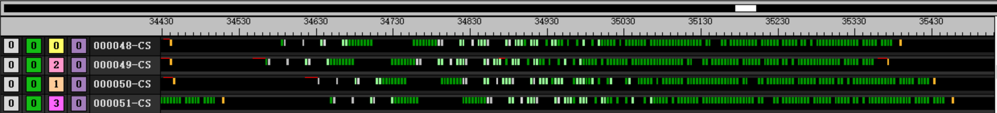
DPP FOR FFT
Method 2
Method 2: dpp
Only need to wait reading twiddle from global mem (good)
Compiler will generate lots of condition branch instructions (compiler issue)
One wave will holding VALU during butterfly calculate, can’t interleave with other wave(not good)
948 clk
load twiddle
lots of condition
butterfly
Wait load twiddle complete

Slide 6
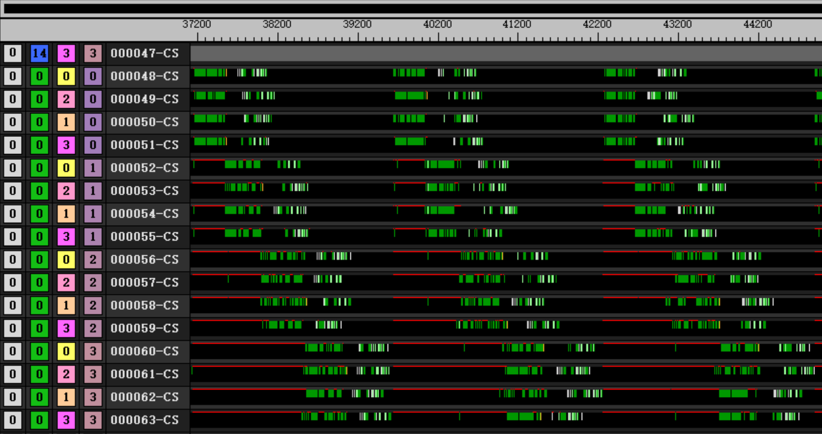
DPP FOR FFT
Method 2
Method 2: dpp
One wave will holding VALU during butterfly calculate, can’t interleave with other waves well (not good)
Waiting global load
Waiting other waves

Slide 7
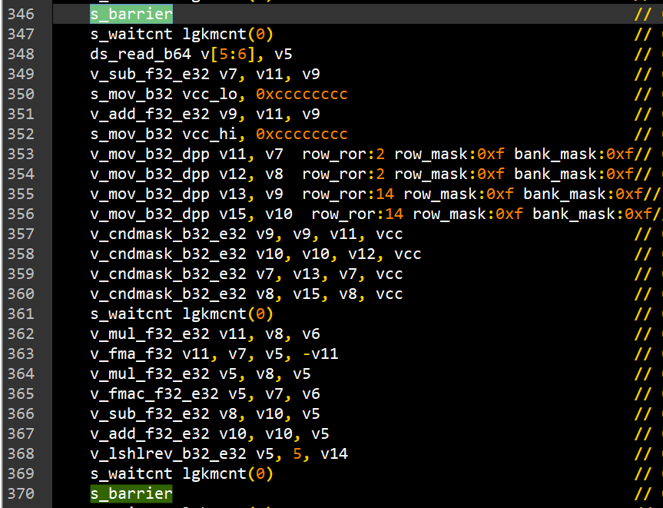
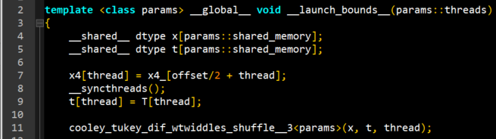
DPP FOR FFT
Method 3
Method 3: dpp with twiddle in lds
Compiler can’t generate correct code, only work with –O0 (compiler issue)
Only read from lds, so no need to sync

Slide 8
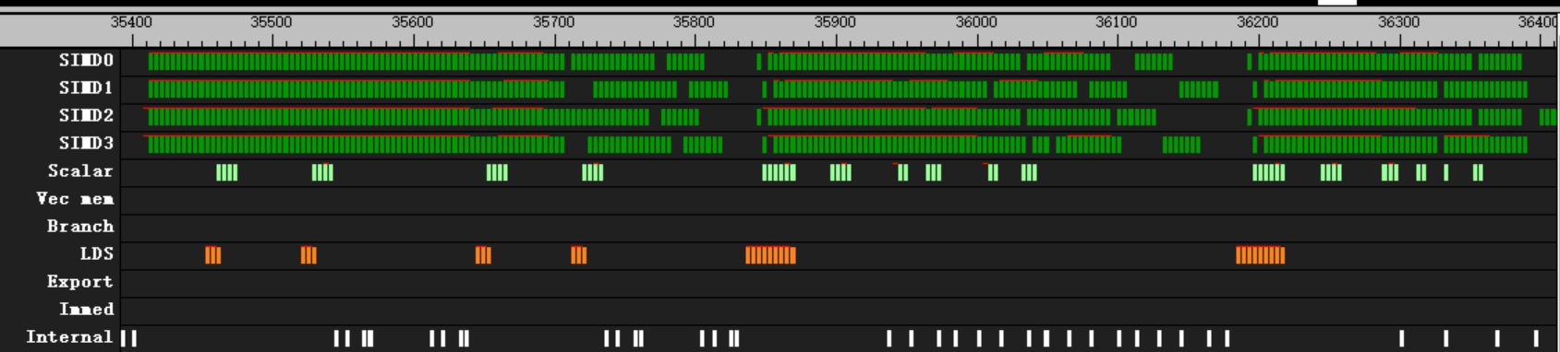
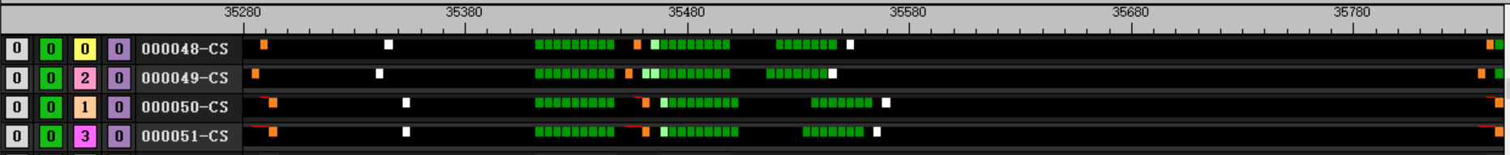
DPP FOR FFT
Method 3
Method 3: dpp with twiddle in lds
Lds_read, S_waitcnt , valu instructions in wrong orders (compiler issue)
Different waves could interleave, better than origin method (good)
208 clk
read twiddle from lds
butterfly

Slide 9
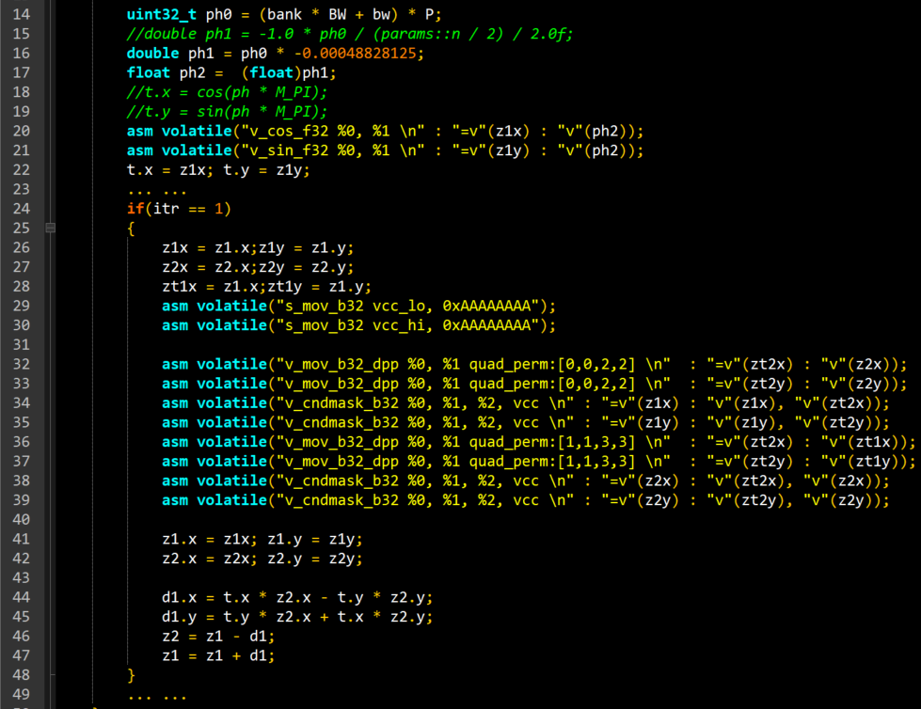
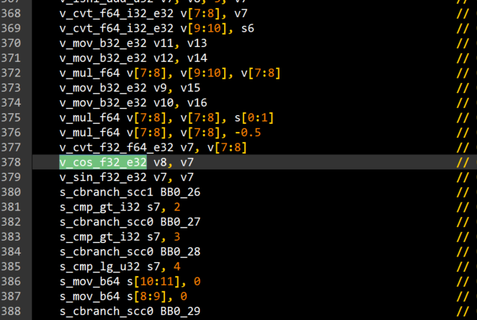
DPP FOR FFT
Method 4
Method 4: dpp with twiddle in flight
Use double precision to calculate phase
Use v_cos/sin_f32 instruction to calculate twiddle

Slide 10
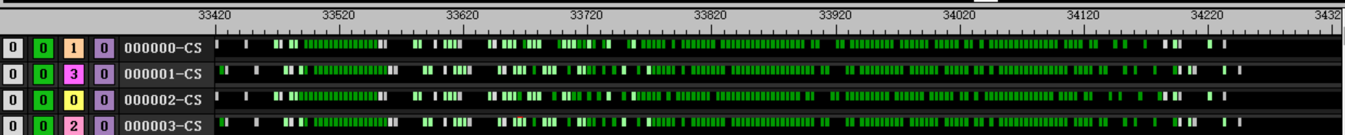
DPP FOR FFT
Method 4
Method 4: dpp with twiddle in flight
840 clk
butterfly
Condition
Calculate twiddle

Slide 11
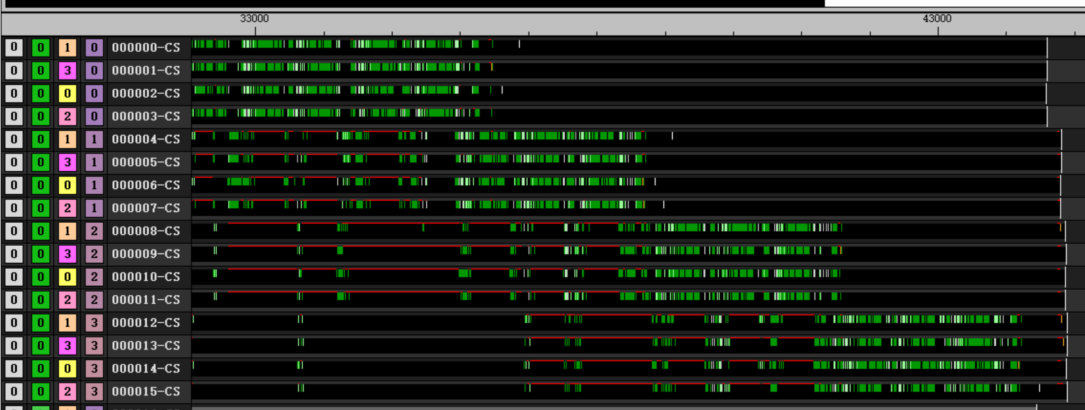
DPP FOR FFT
Method 4
Method 4: dpp with twiddle in flight
One wave will holding VALU during butterfly calculate, can’t interleave with other waves at all (not good)
Waiting other waves

Slide 12
DPP FOR FFT
Conclusion ：
Use dpp with load twiddle in lds (if we could avoid compiler issue)
It has fewer instructions
Different wave could interleave while waiting for lds_read

